Slide 1
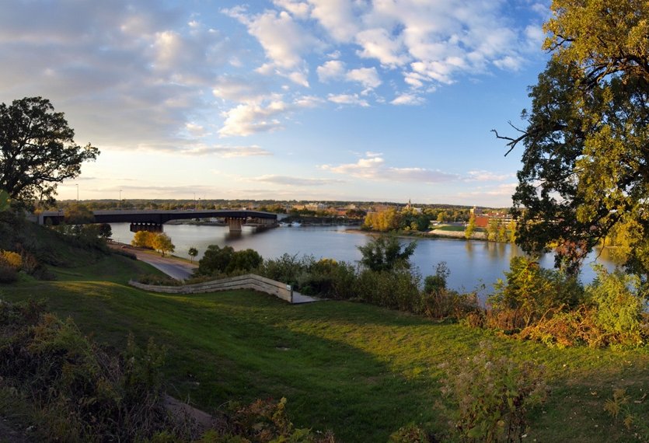
City of Ottawa
STATE OF THE CITY
Thursday, October 7, 2010
11:30 a.m.

Slide 2
THE CHAMBER
OTTAWA AREA CHAMBER
OF COMMERCE & INDUSTRY

Slide 4
City Commissioners
Commissioner Dan Aussem
Commissioner Ed Whitney
Commissioner Dale Baxter
Commissioner Wayne Eichelkraut

Slide 5
Construction Permits
This Year
$47.5 Million
Last Year
$28 Million

Slide 6
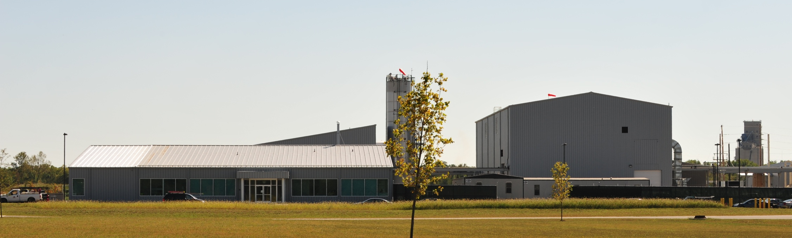
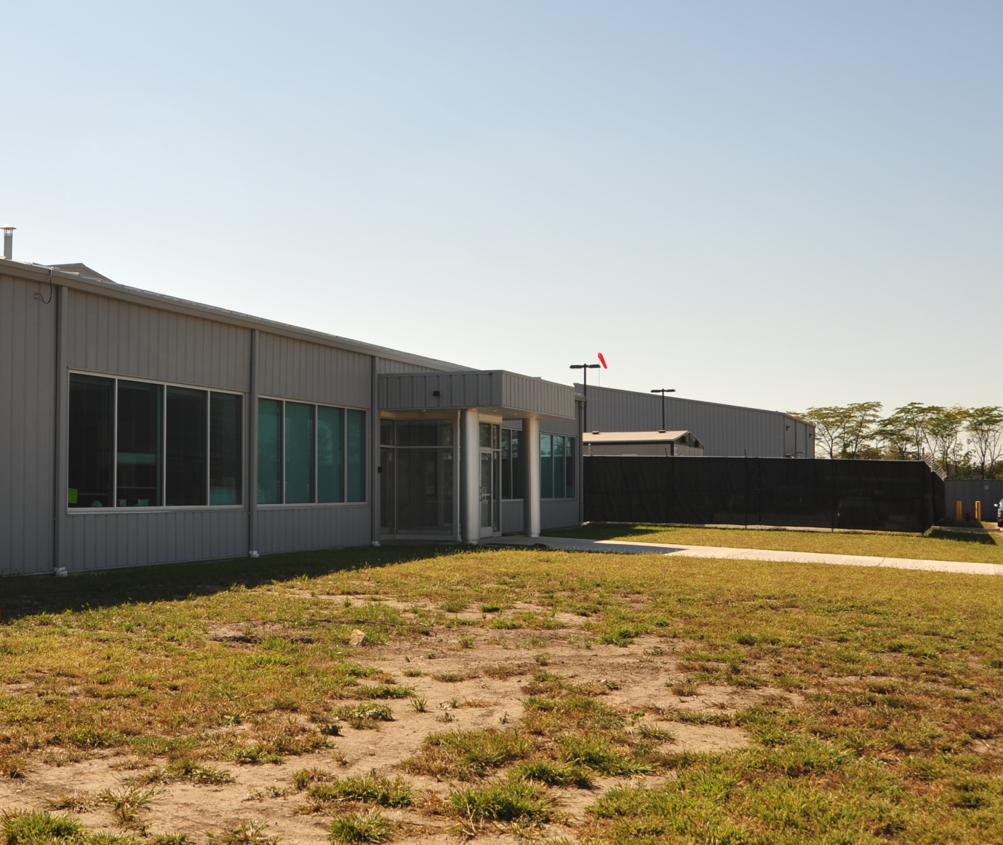
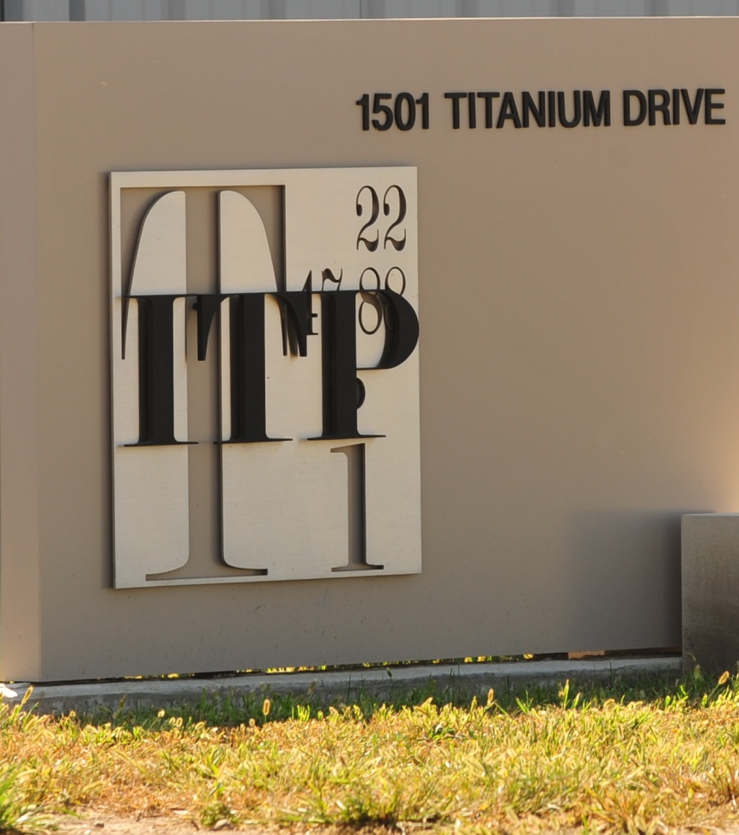

Slide 7
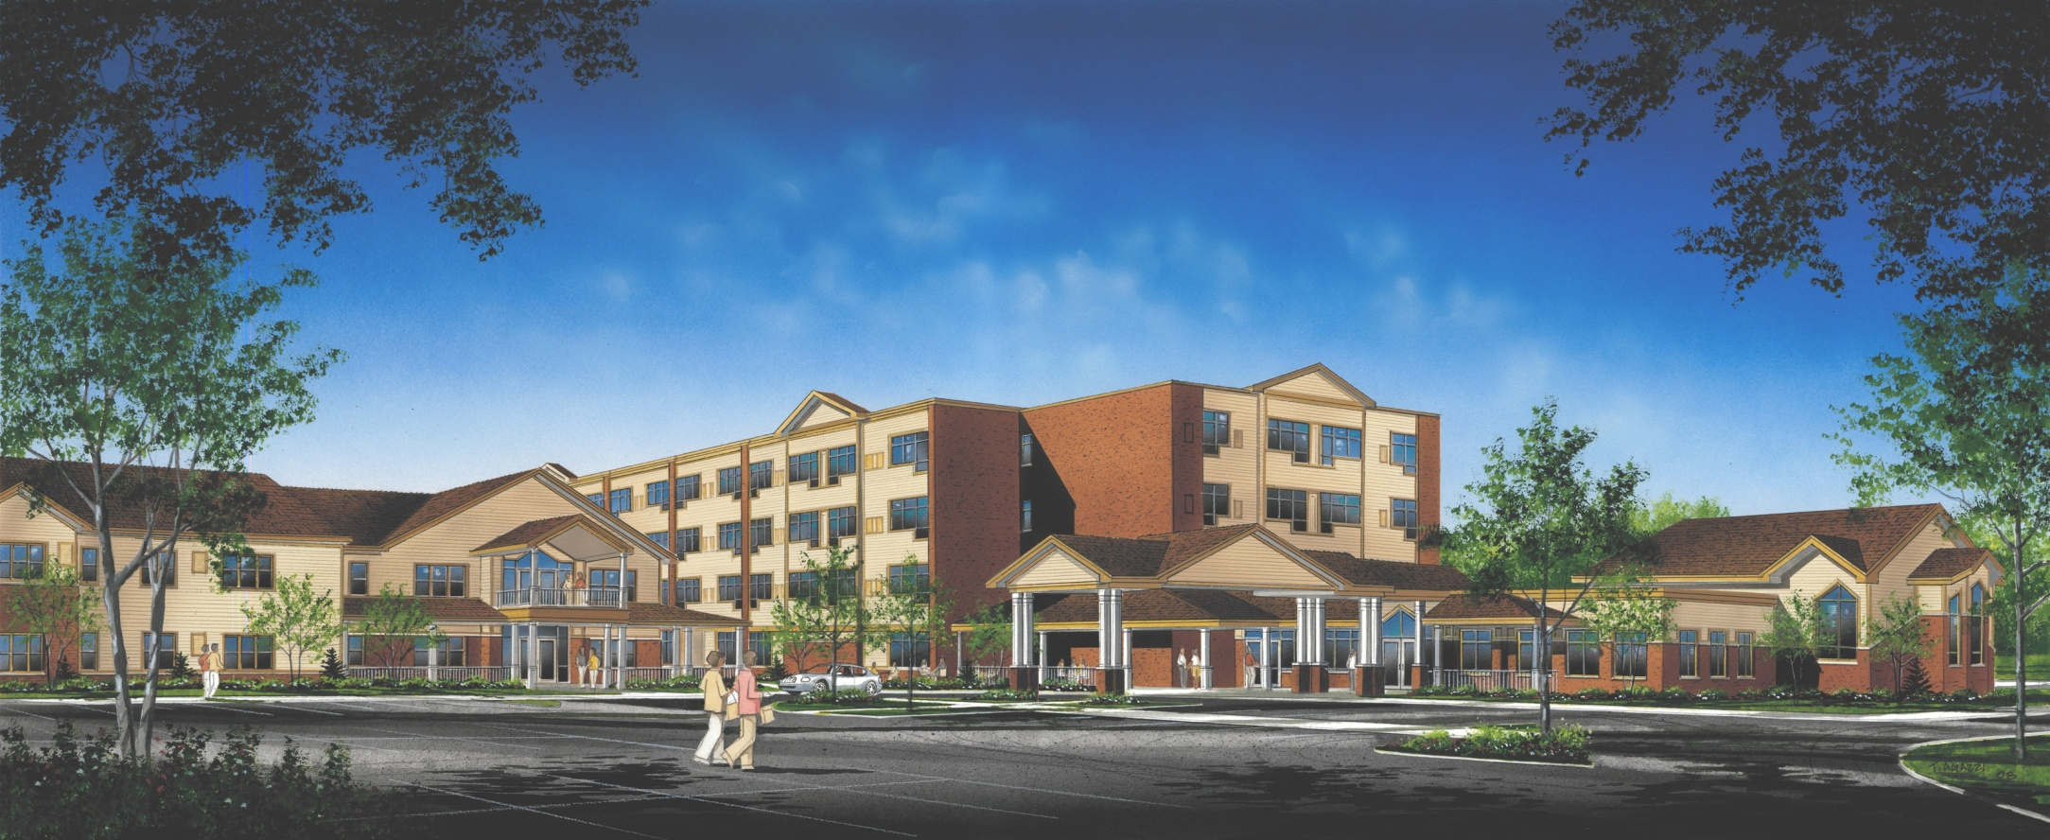
Pleasant View
A Lutheran Life Community

Slide 8
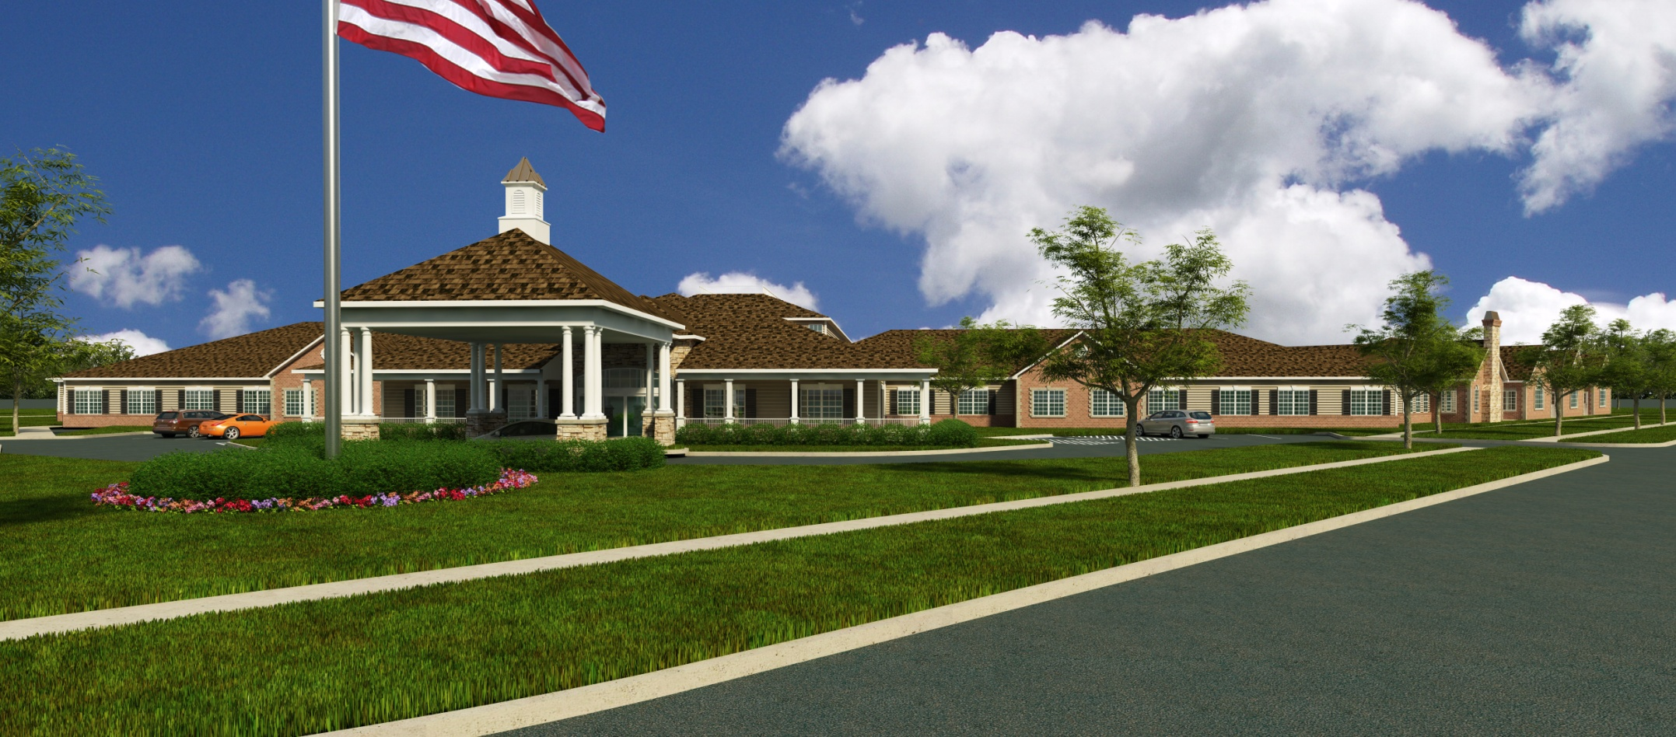
Ottawa Pavilion

Slide 9
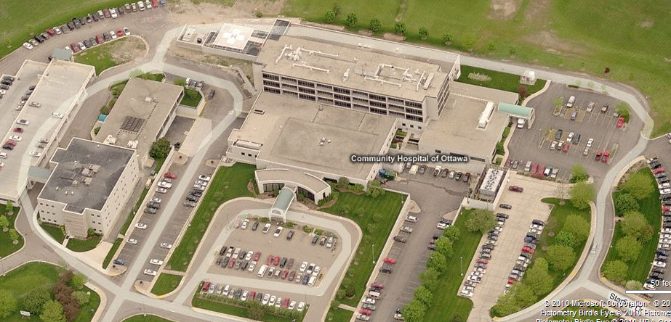
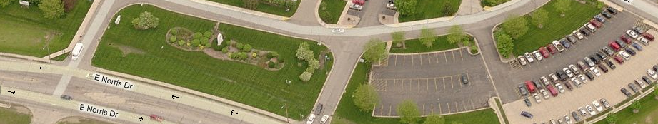
Ottawa Regional Hospital

Slide 10
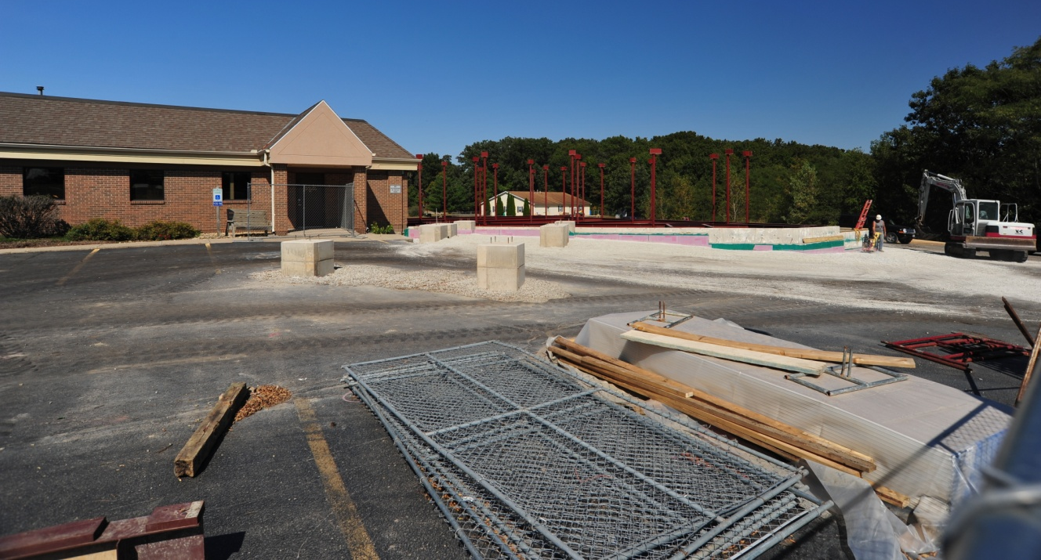
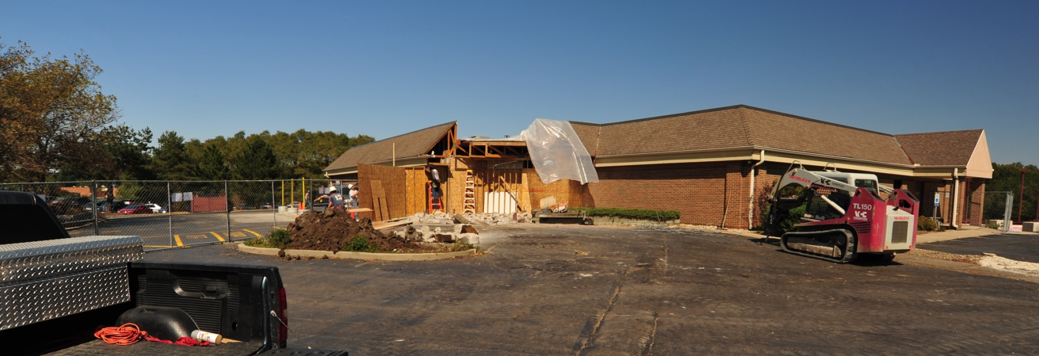
Ottawa Regional Hospital
Urgent
Visit
Center

Slide 11
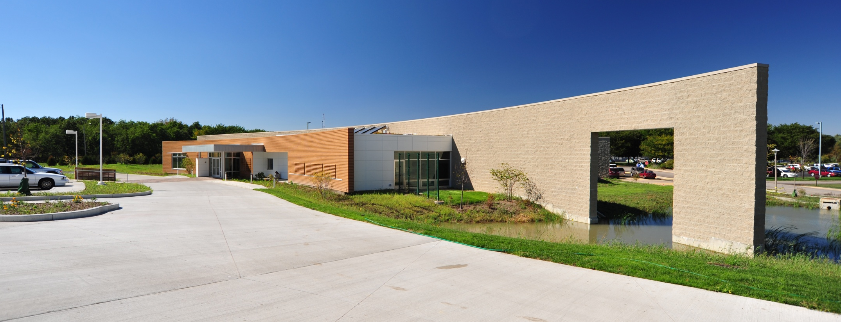
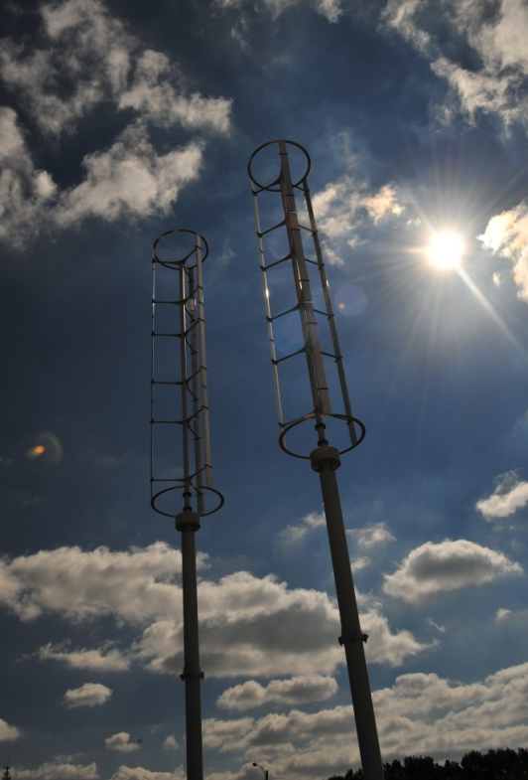
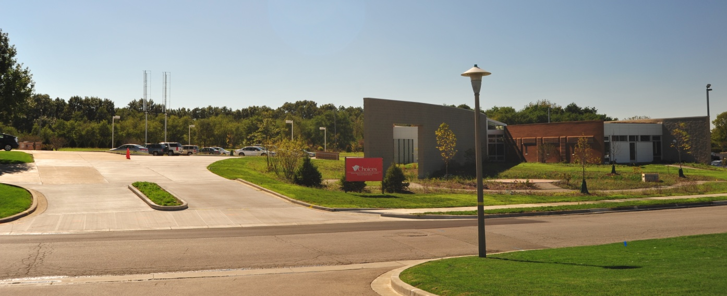
Mental Health Facility

Slide 12
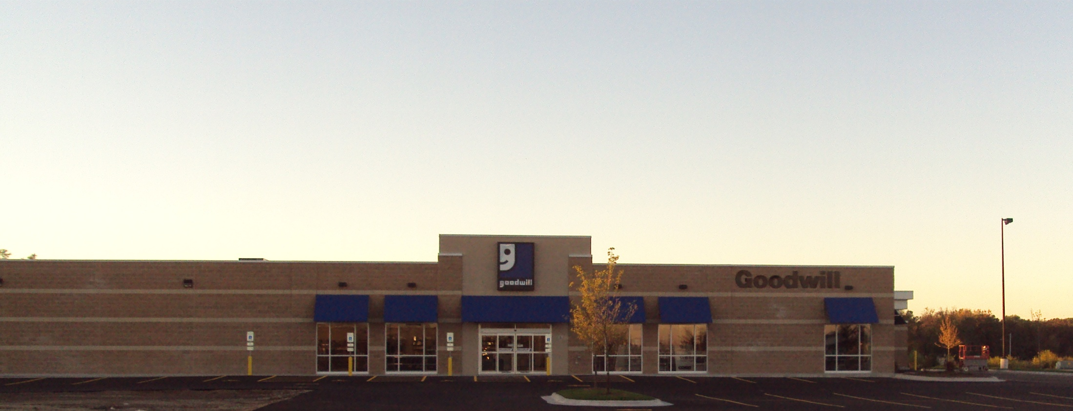
Goodwill Industries

Slide 13
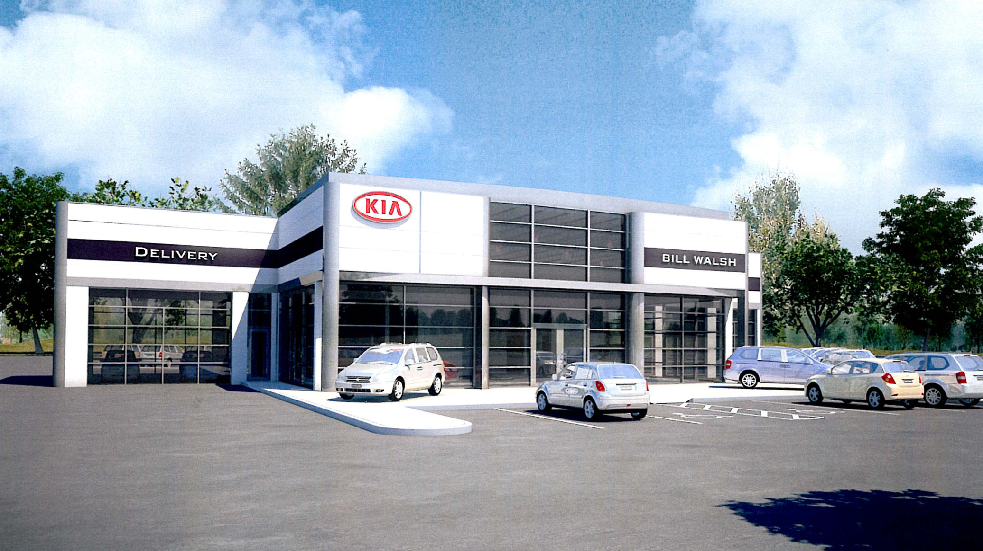
Bill Walsh Automotive Group
KIA

Slide 14
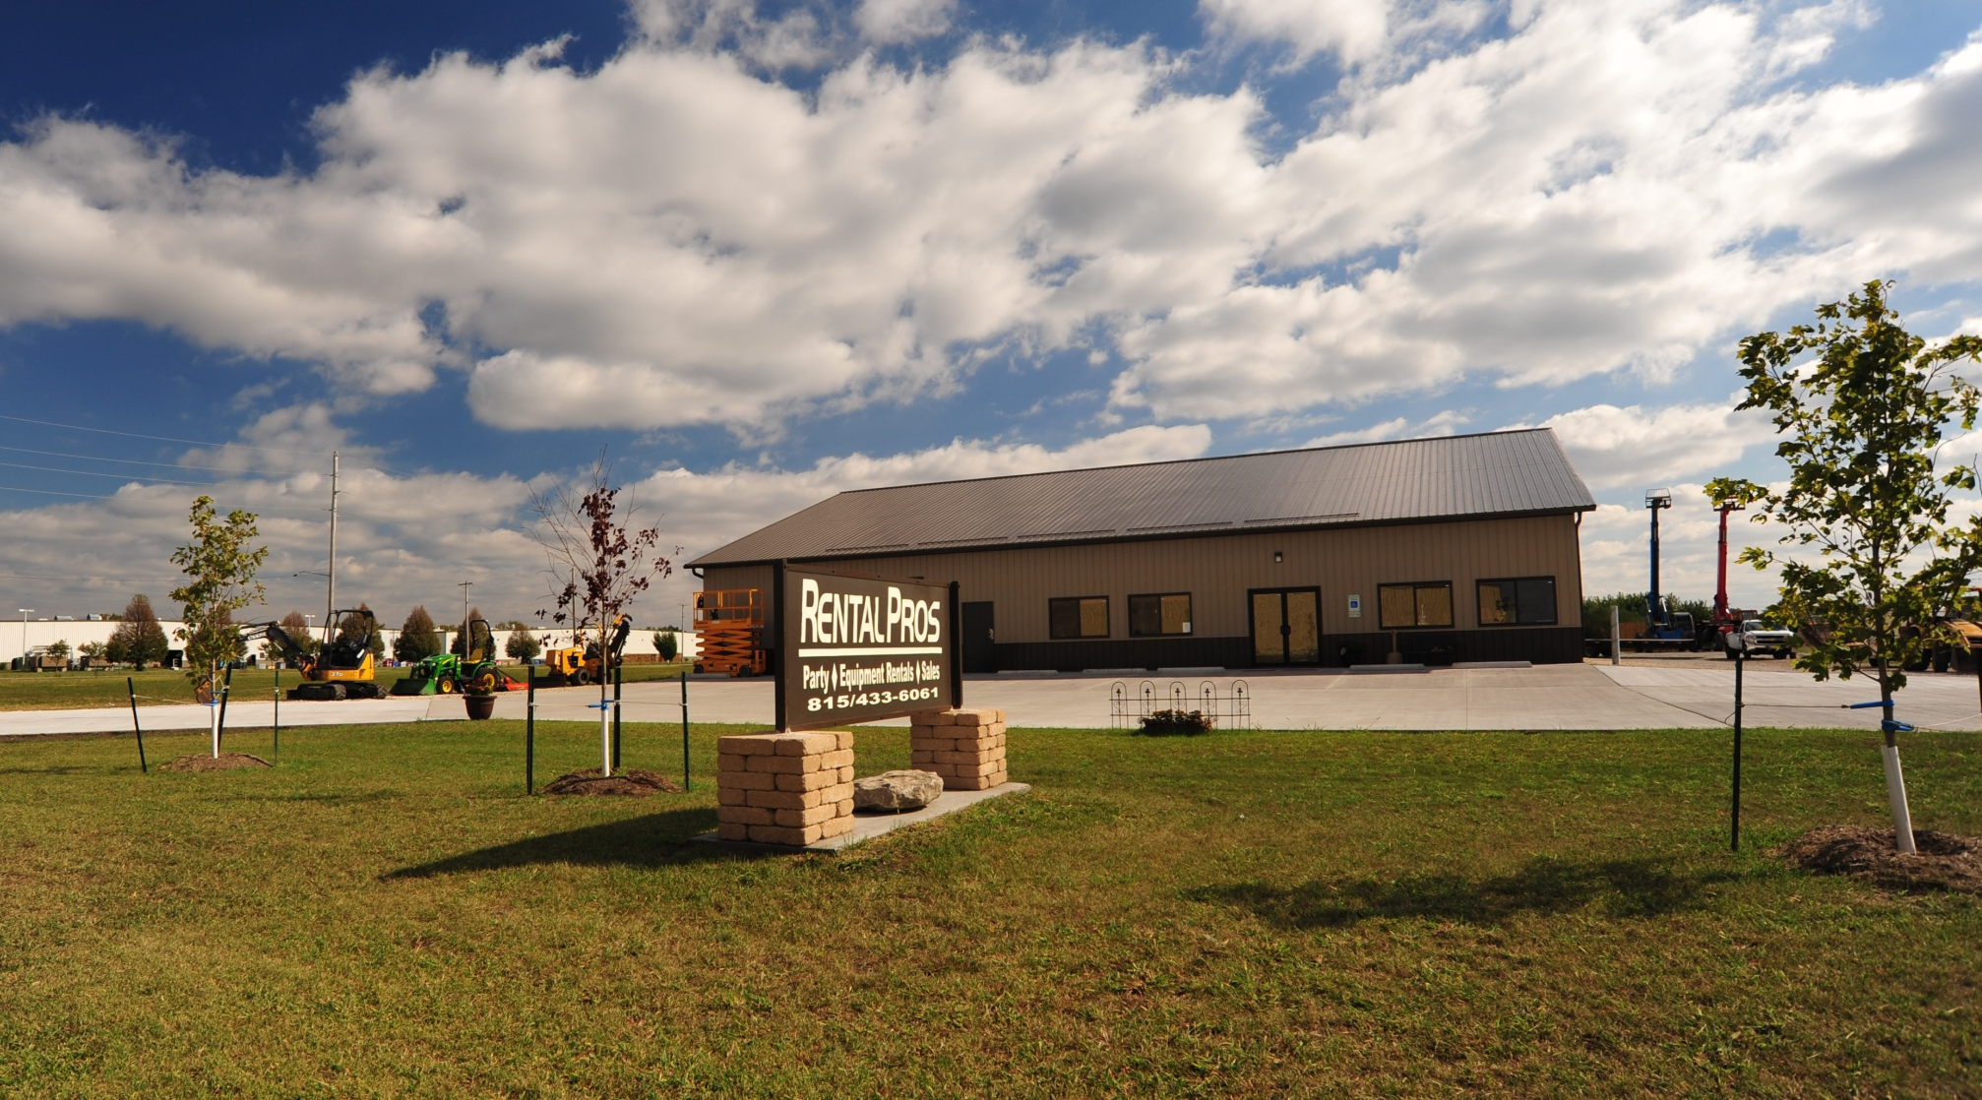
Rental Pros

Slide 15
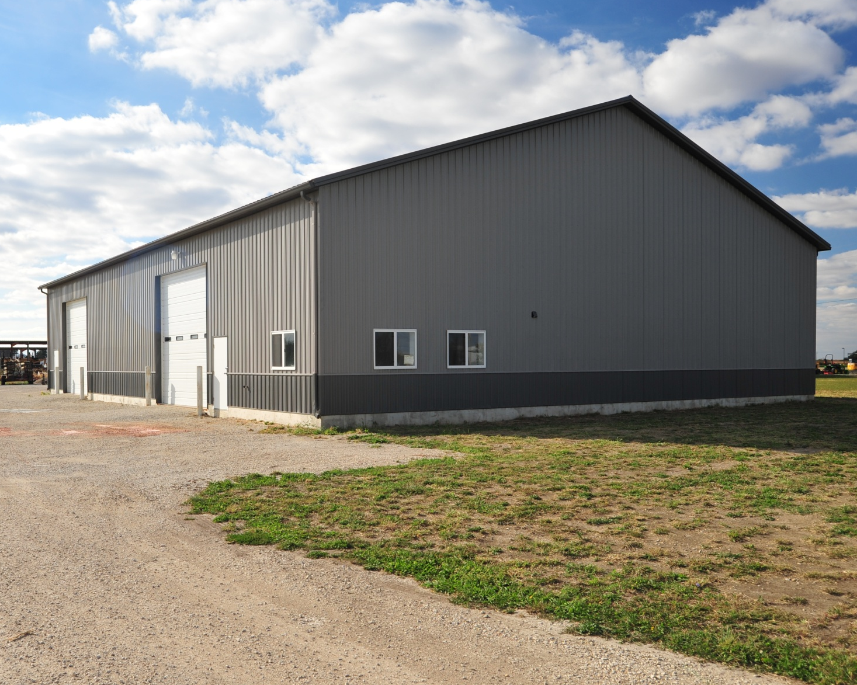
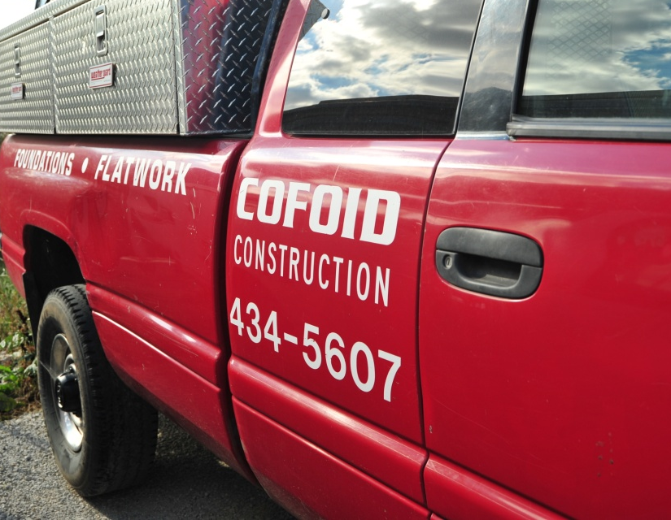

Slide 16
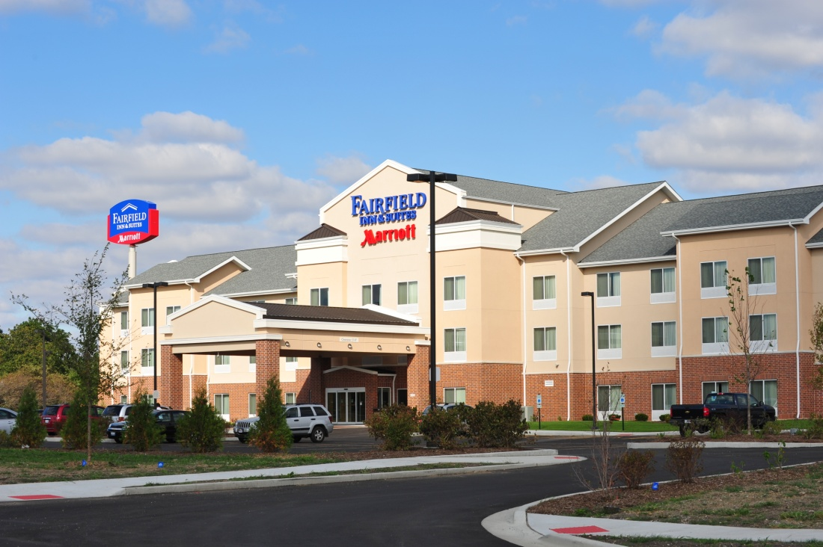

Slide 17
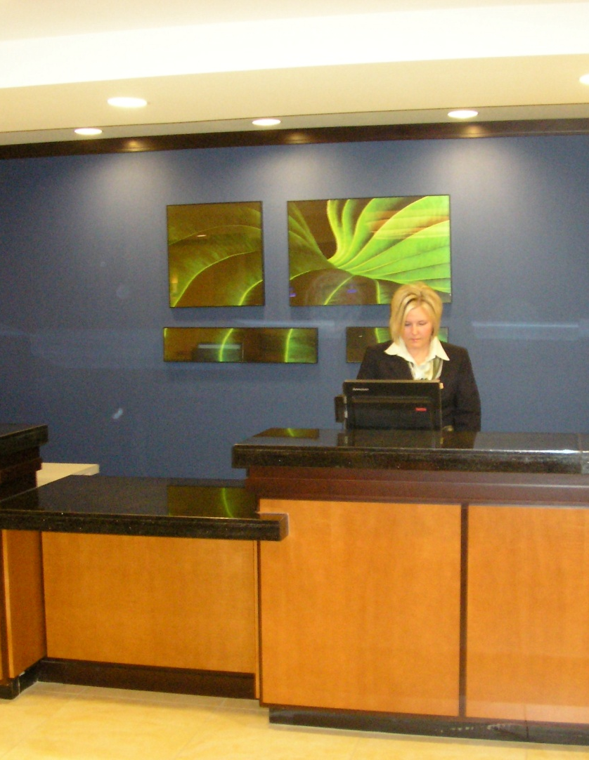
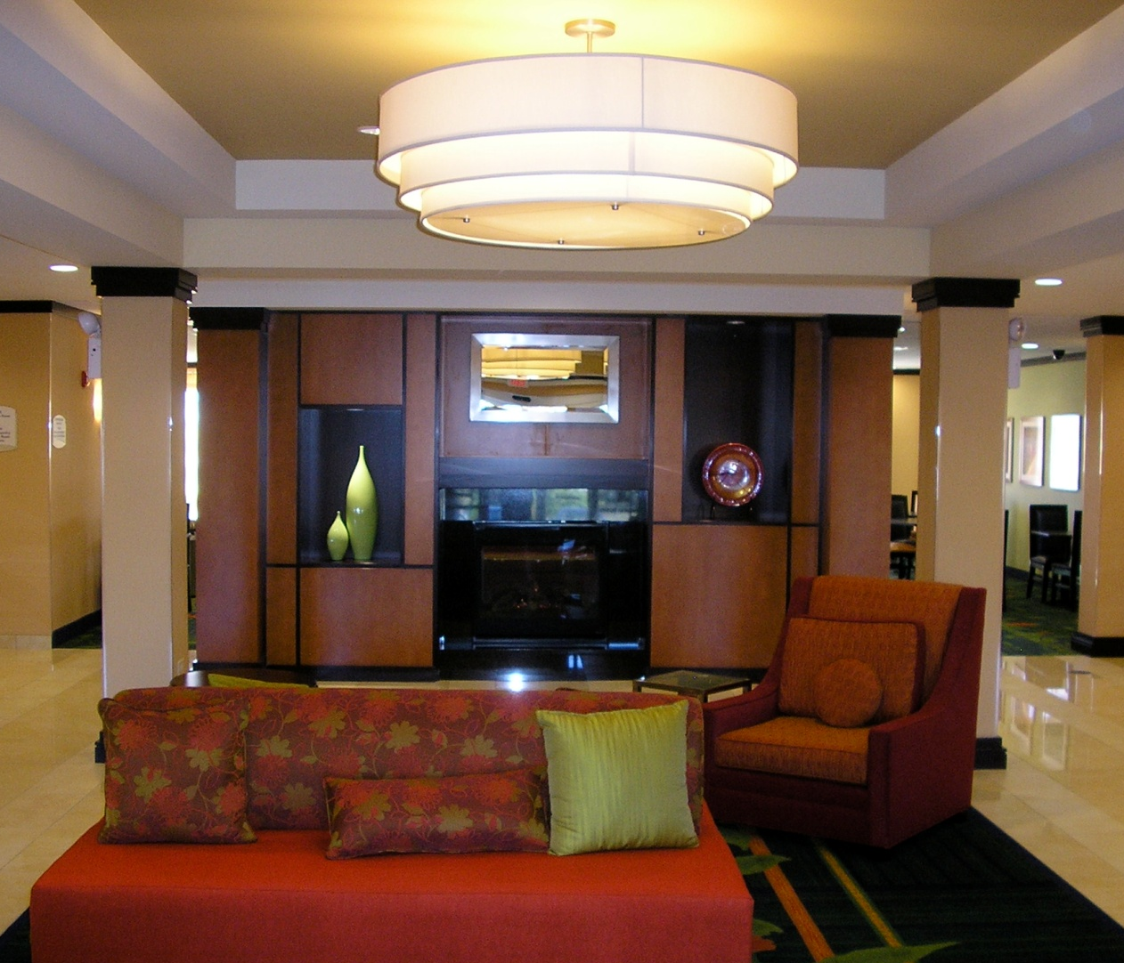
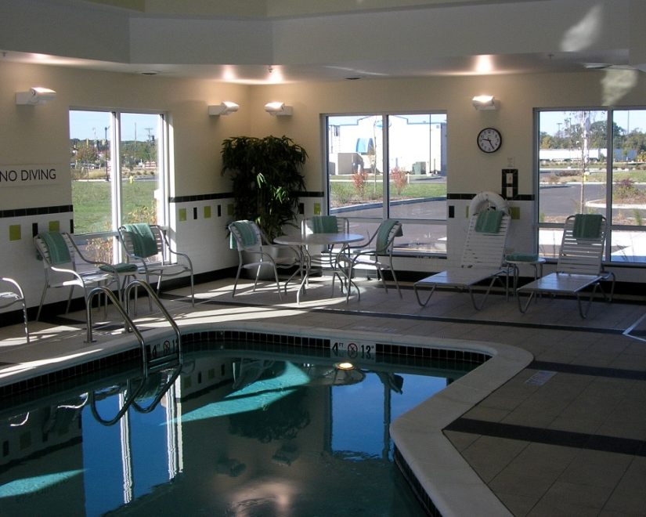

Slide 18
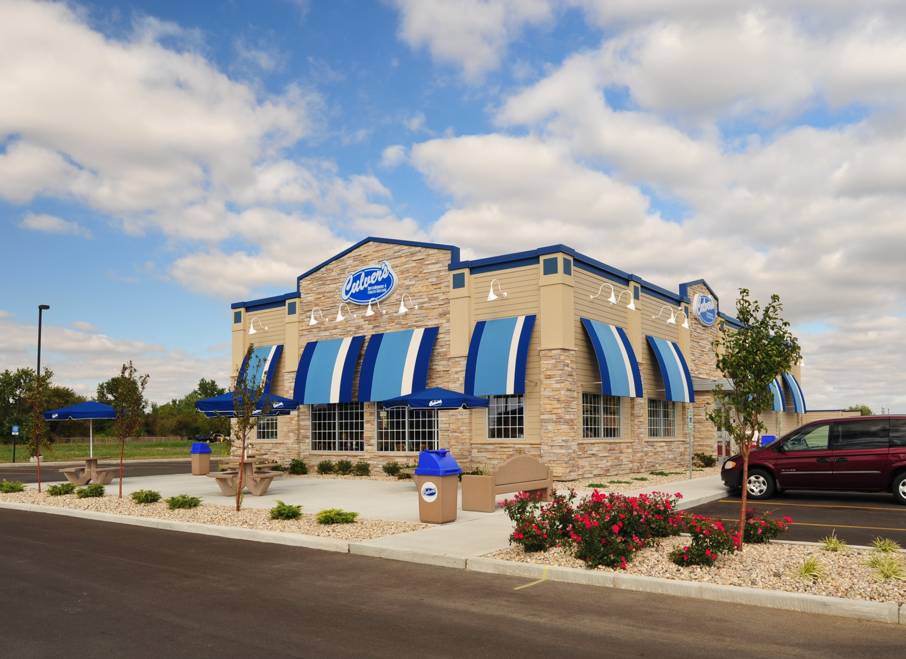

Slide 19
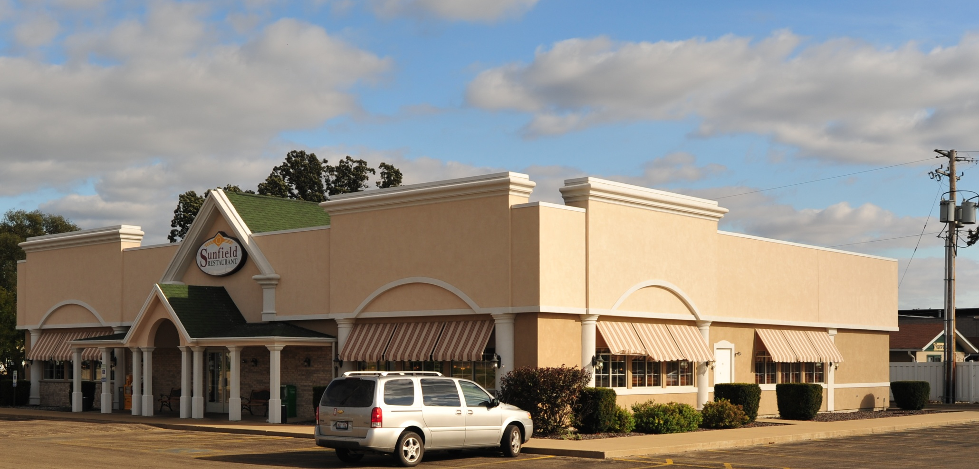
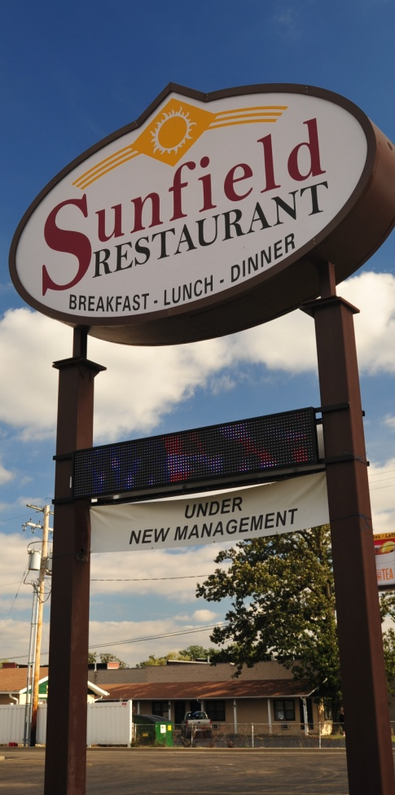

Slide 20
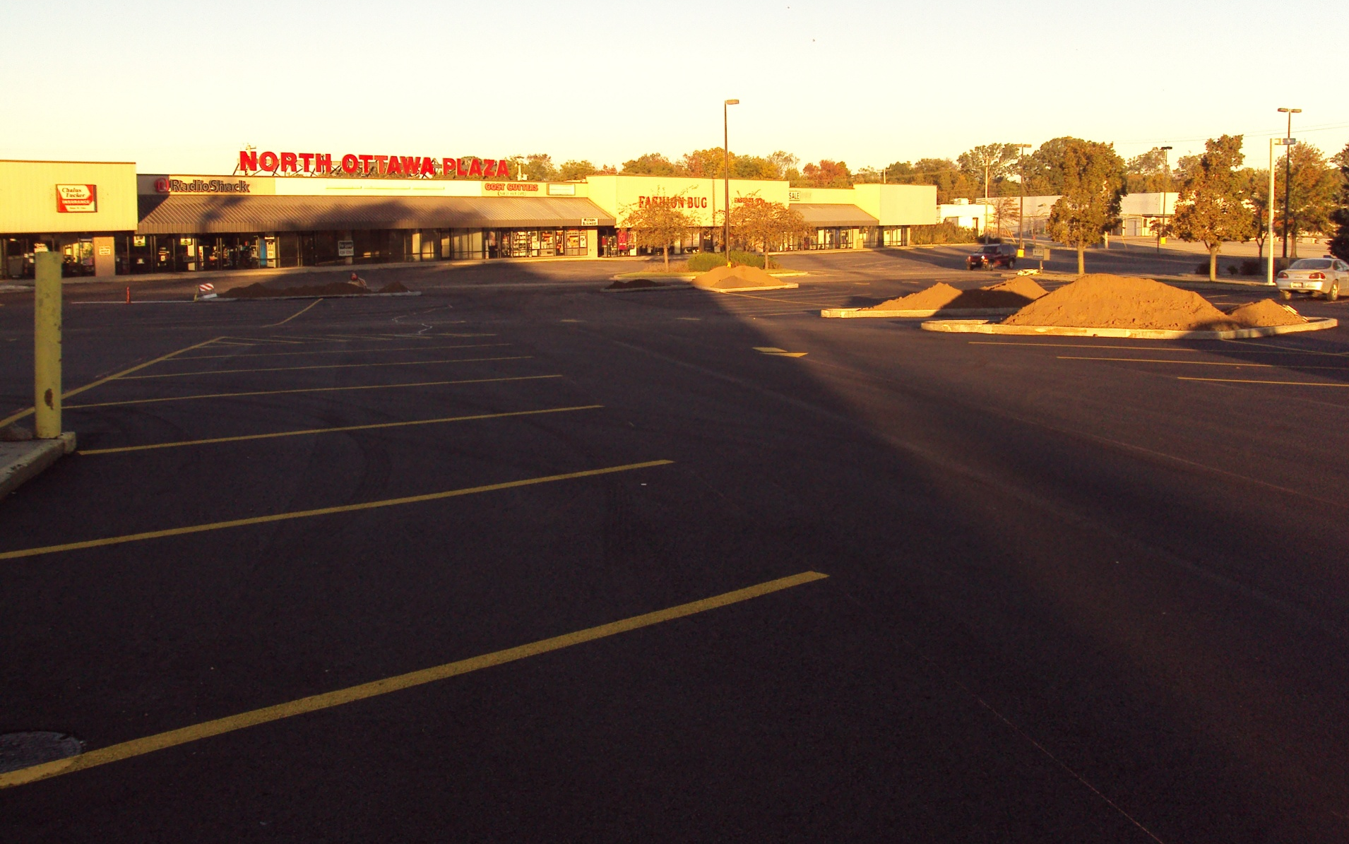
Ponderosa – Parking Lot

Slide 21
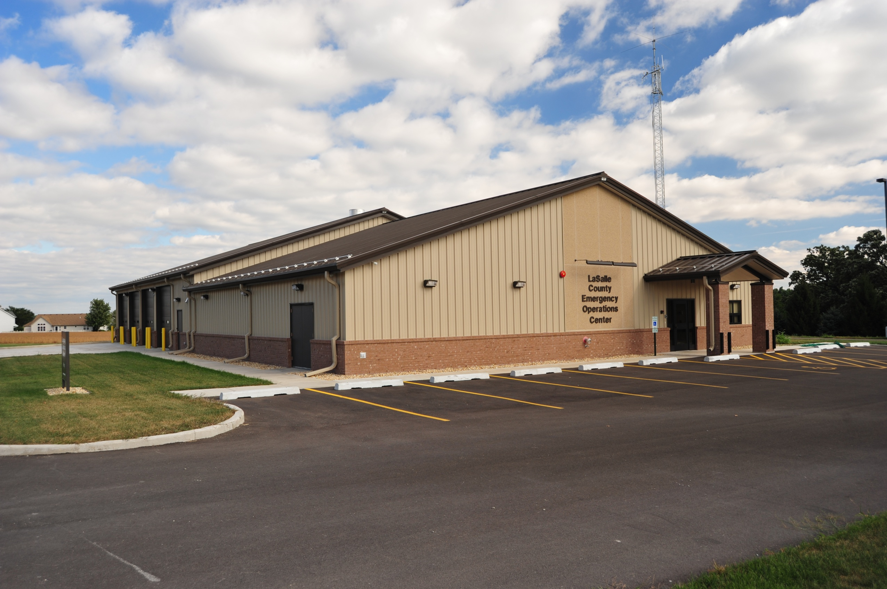
LaSalle County Emergency Operations Center

Slide 22
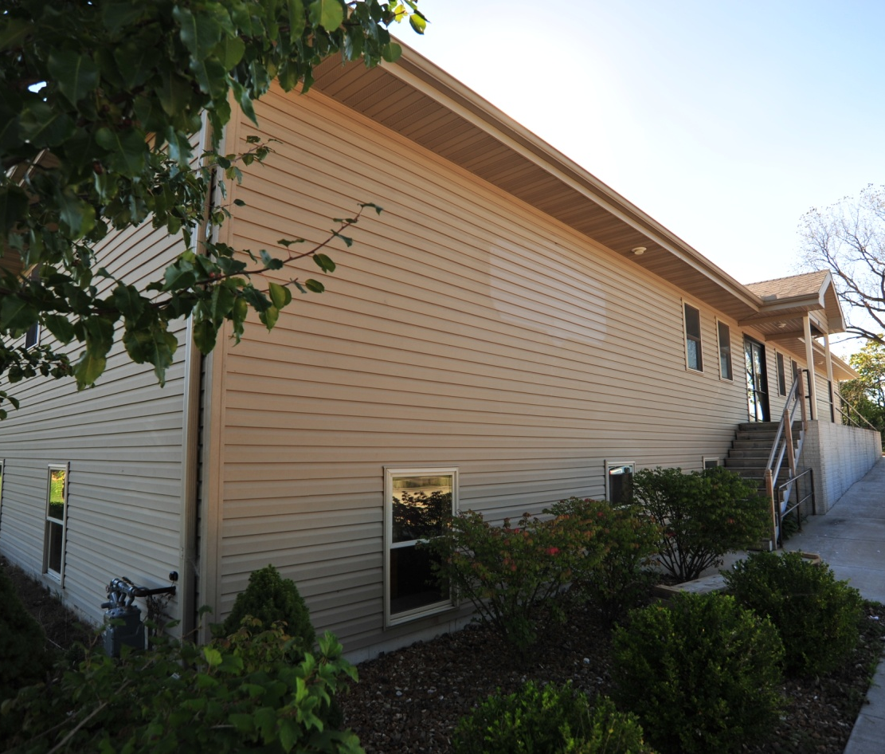
North Central Illinois Council of Governments

Slide 23
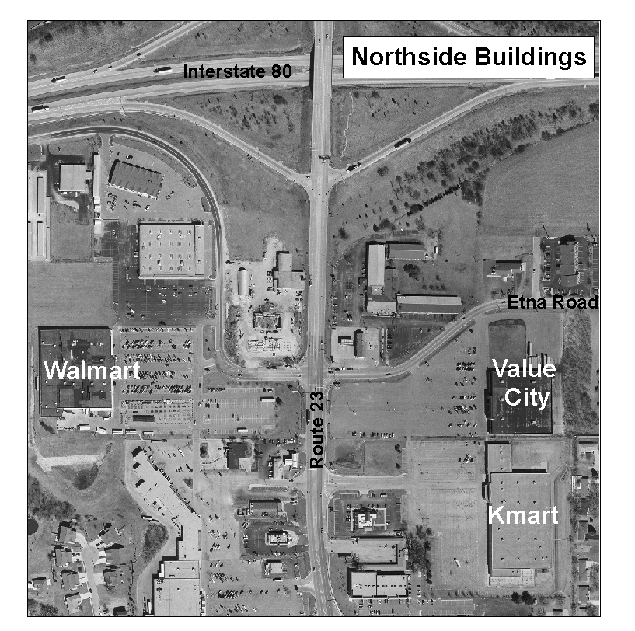

Slide 24
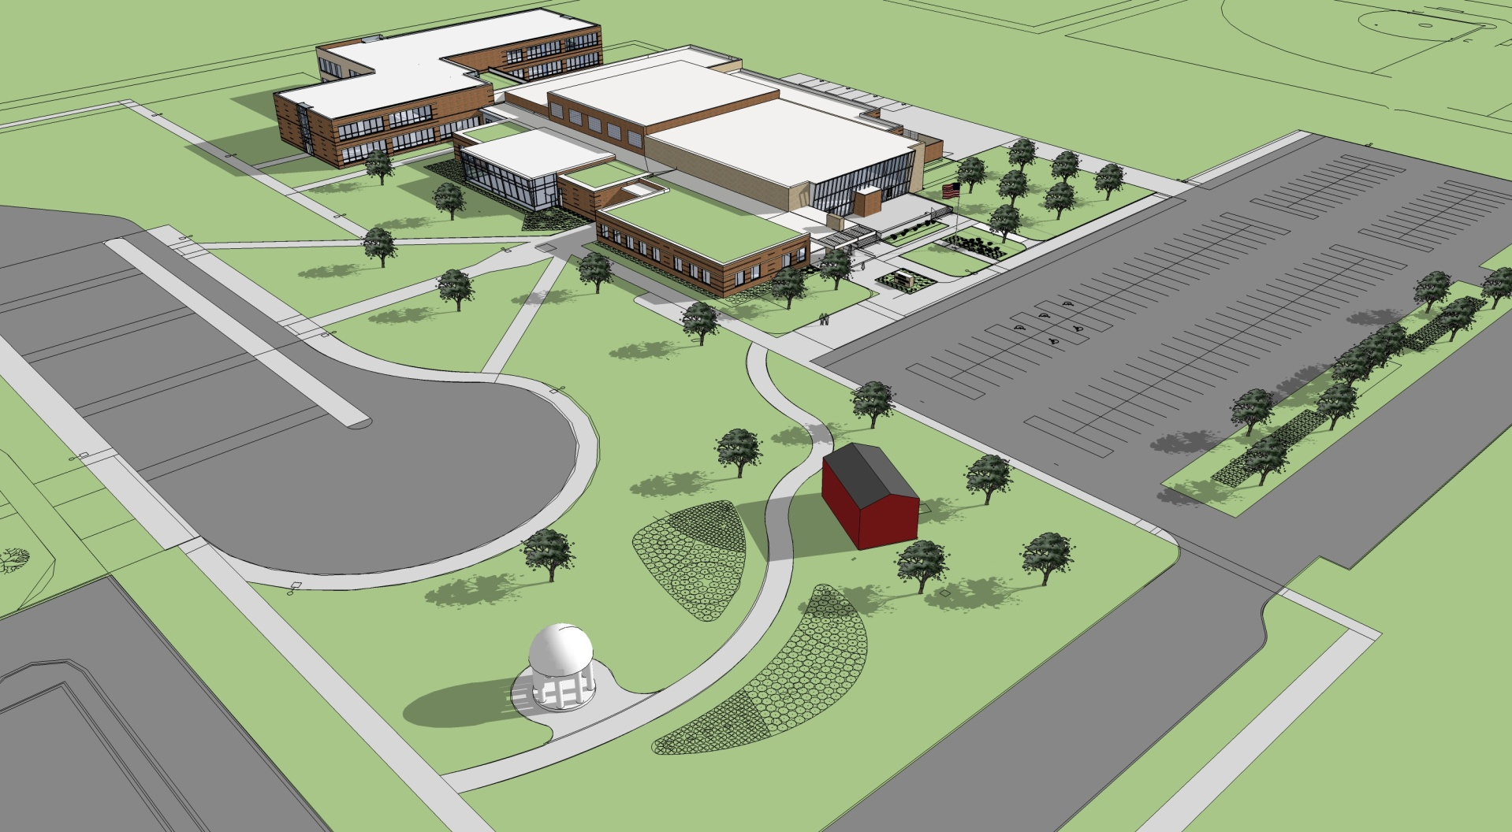
Central Intermediate School

Slide 25
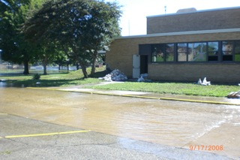
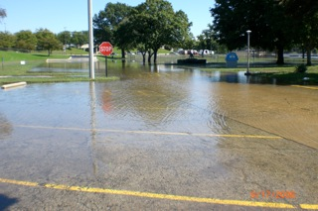
Flooding

Slide 26
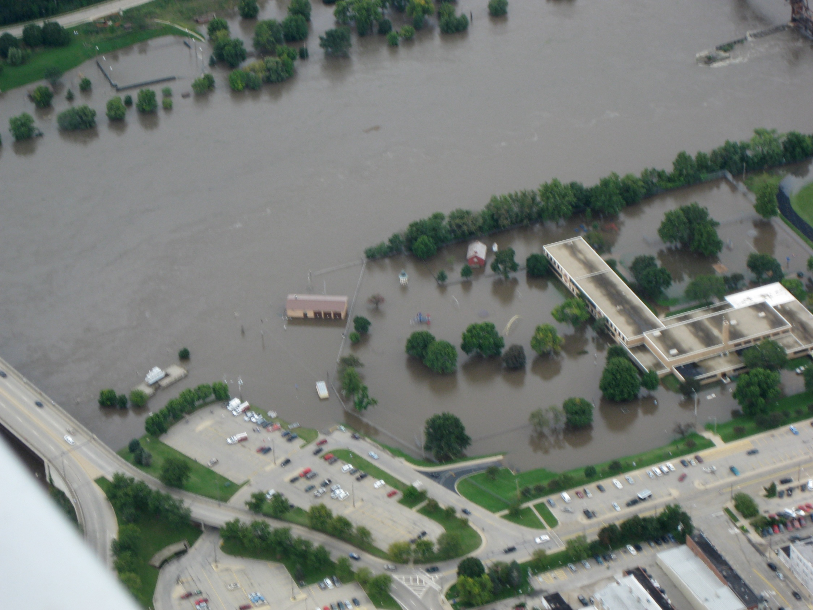
Ottawa Elementary School
Central School Flooding

Slide 27
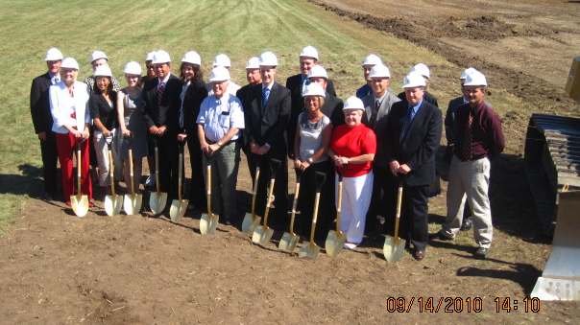
Partnerships

Slide 28
GRANTS

Slide 29
Stimulus Funding
$570,000 for Streets
$7.35 million for the Wastewater Treatment Plant
$2.5 million for Water and Sewer Project

Slide 30
Brownfield Grants
$350,000 in USEPA Brownfield Assessment Grants
Completed Projects
IVCC Ottawa Center
Jordan Block
Lincoln Place Parking lot
Rich Gaul Property – New Neighborhood Park
Proposed Projects
Marquette Street Corridor
Advance Asphalt Property
Former Jimmy John’s

Slide 31
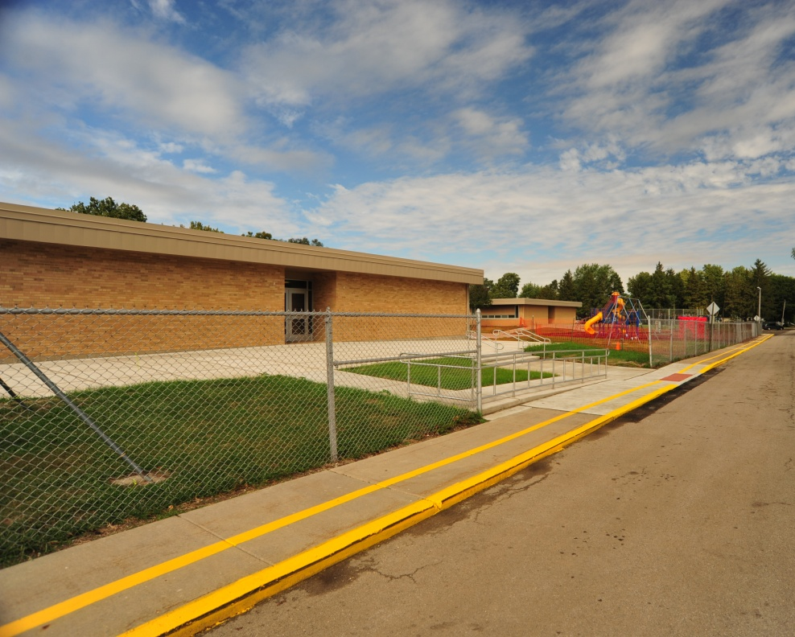
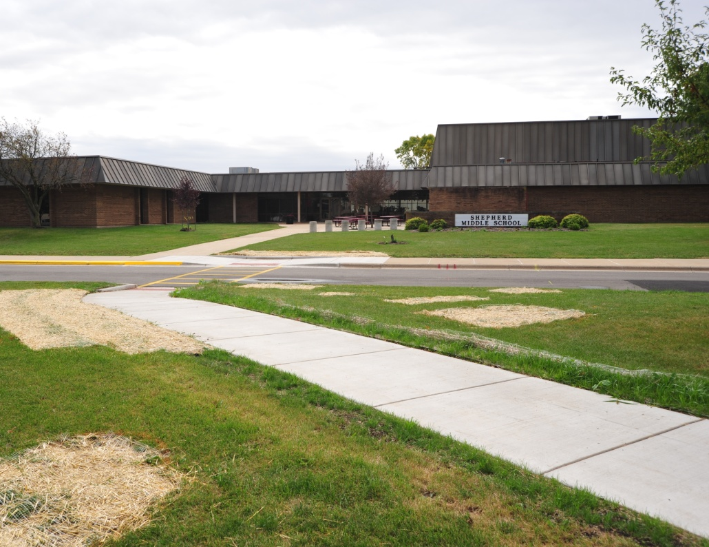
Other Grants
Safe Routes to School Grant

Slide 32
Other Grants
$250,000 – East Dayton Road Widening
$338,000 – Plant trees along the gateways
$75,000 – LEED elements for IVCC Ottawa Center
$56,000 - Downtown Historic Restoration
$12,000 - Eastside Historic Building Survey

Slide 33
NEW GRANT
$350,000 - Watermain on Center Street

Slide 34
Pending Grants
$2.5 millions in ITEP Grants
$600,000 - USEPA Brownfield Assessments and Clean Ups
$100,000 - IVCC Ottawa Campus
$900,000 - IEMA and DCEO buy out flood-prone properties

Slide 35

LaSalle County
Broadband

Slide 36
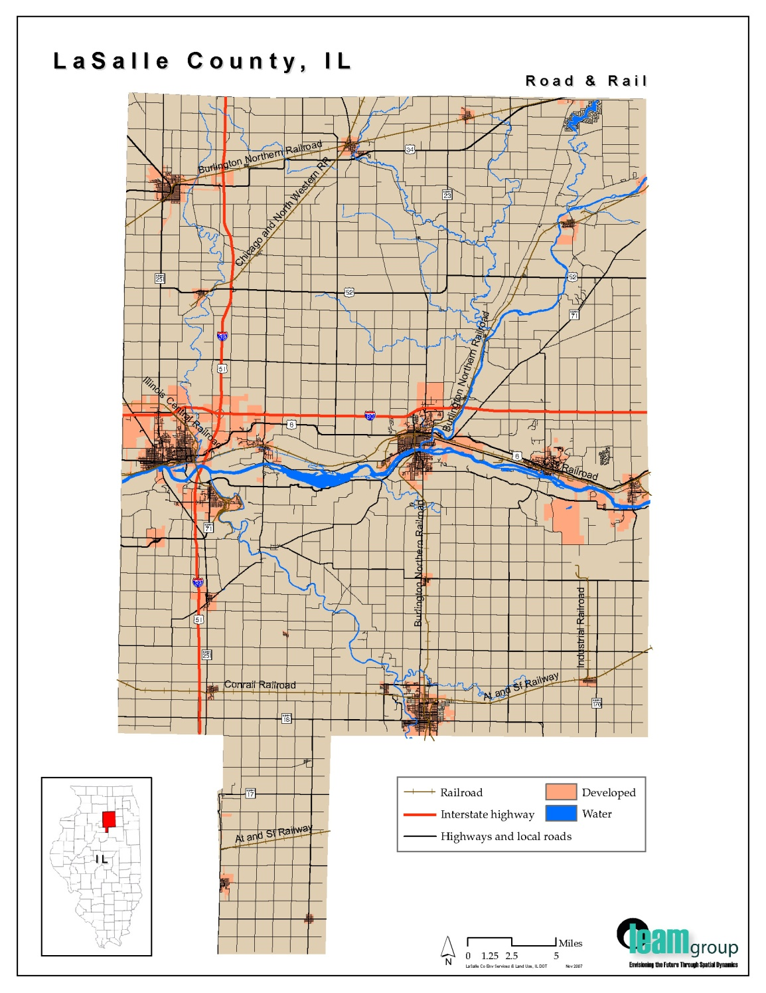
LaSalle
County

Slide 37


LaSalle County
Broadband Initiative
$19 Million
Federal and State Grants

Slide 38
CITY SERVICES

Slide 39

Ottawa Fire Department

Slide 40
Ottawa Fire Department
2500 Medical Calls
450 Fire Calls

Slide 41
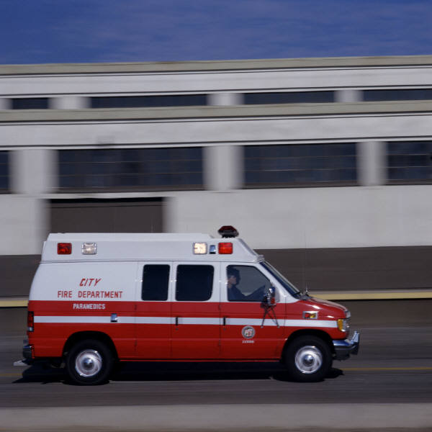

Slide 42

Fire Department
Mutual Aid Box Alarm System (MABAS)
Hazardous Materials Response Team
Technical Rescue Team

Slide 43
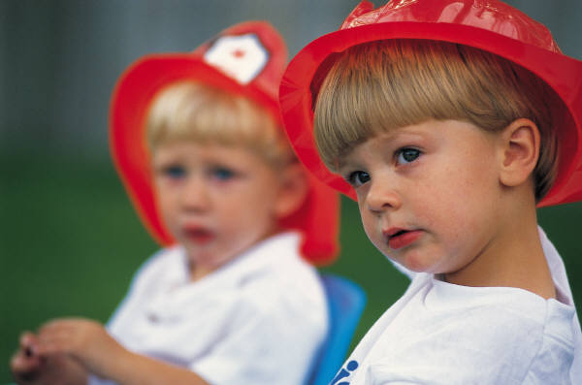
Fire Prevention and Education

Slide 44
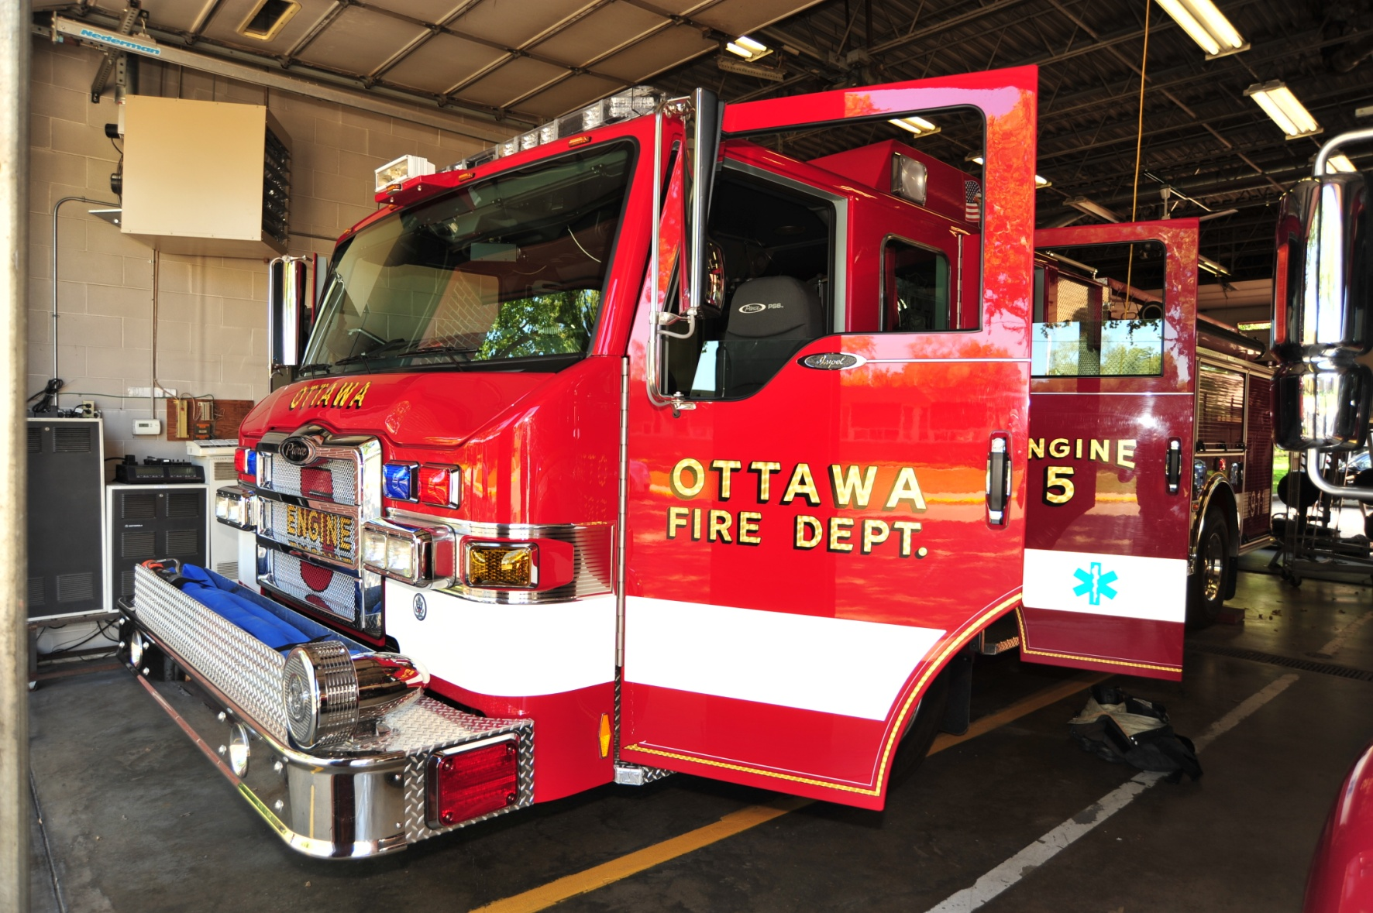
New Fire Truck

Slide 45
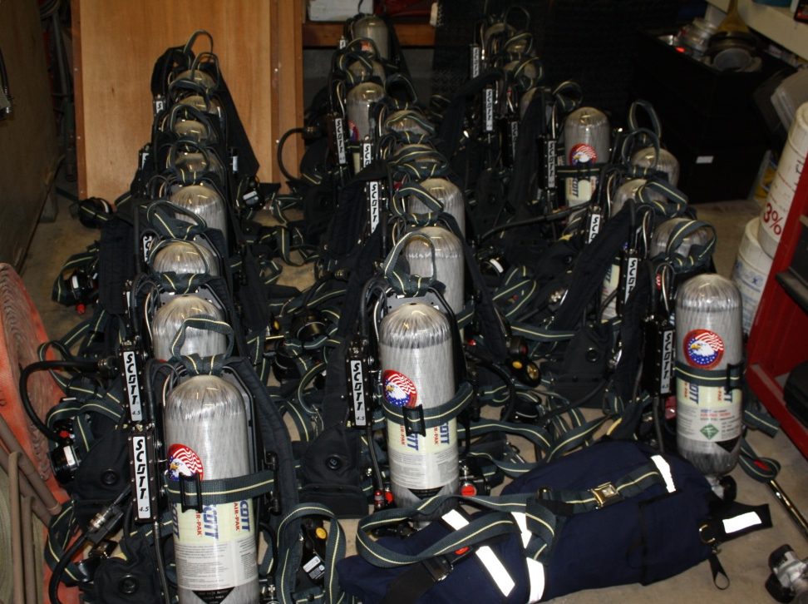
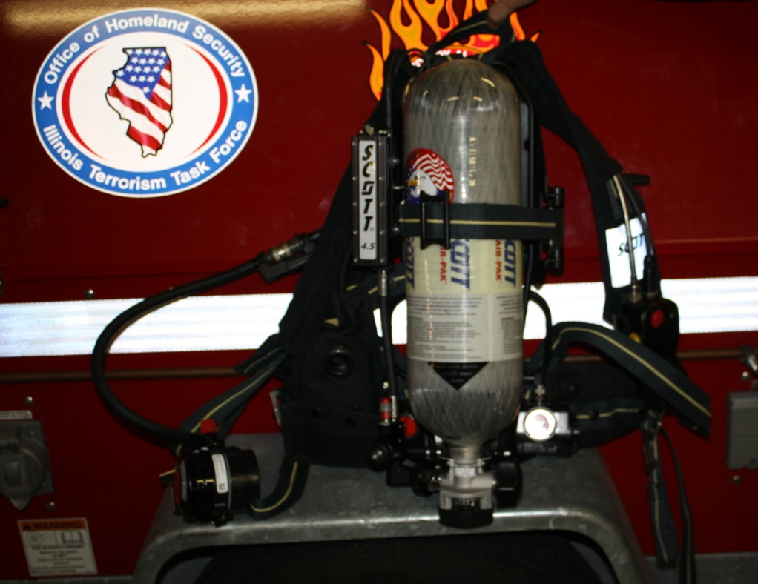
New Airpacks

Slide 46
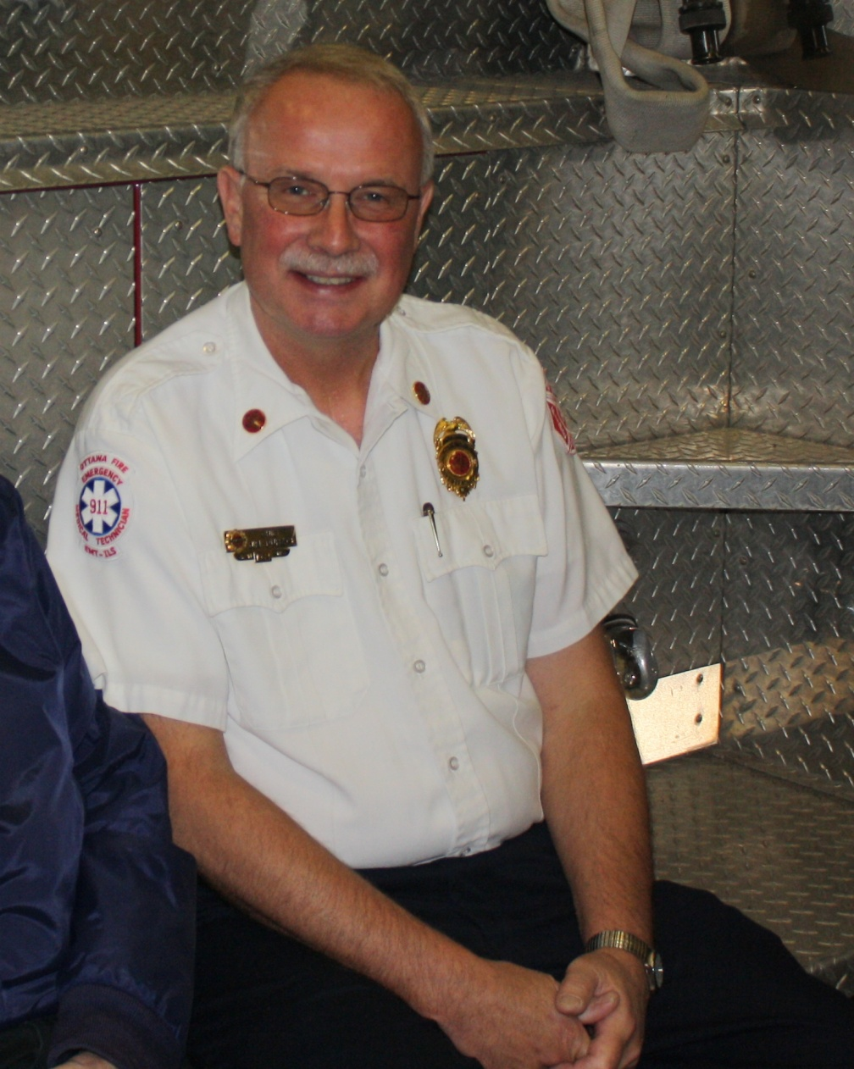
Chief Jim Duback

Slide 47
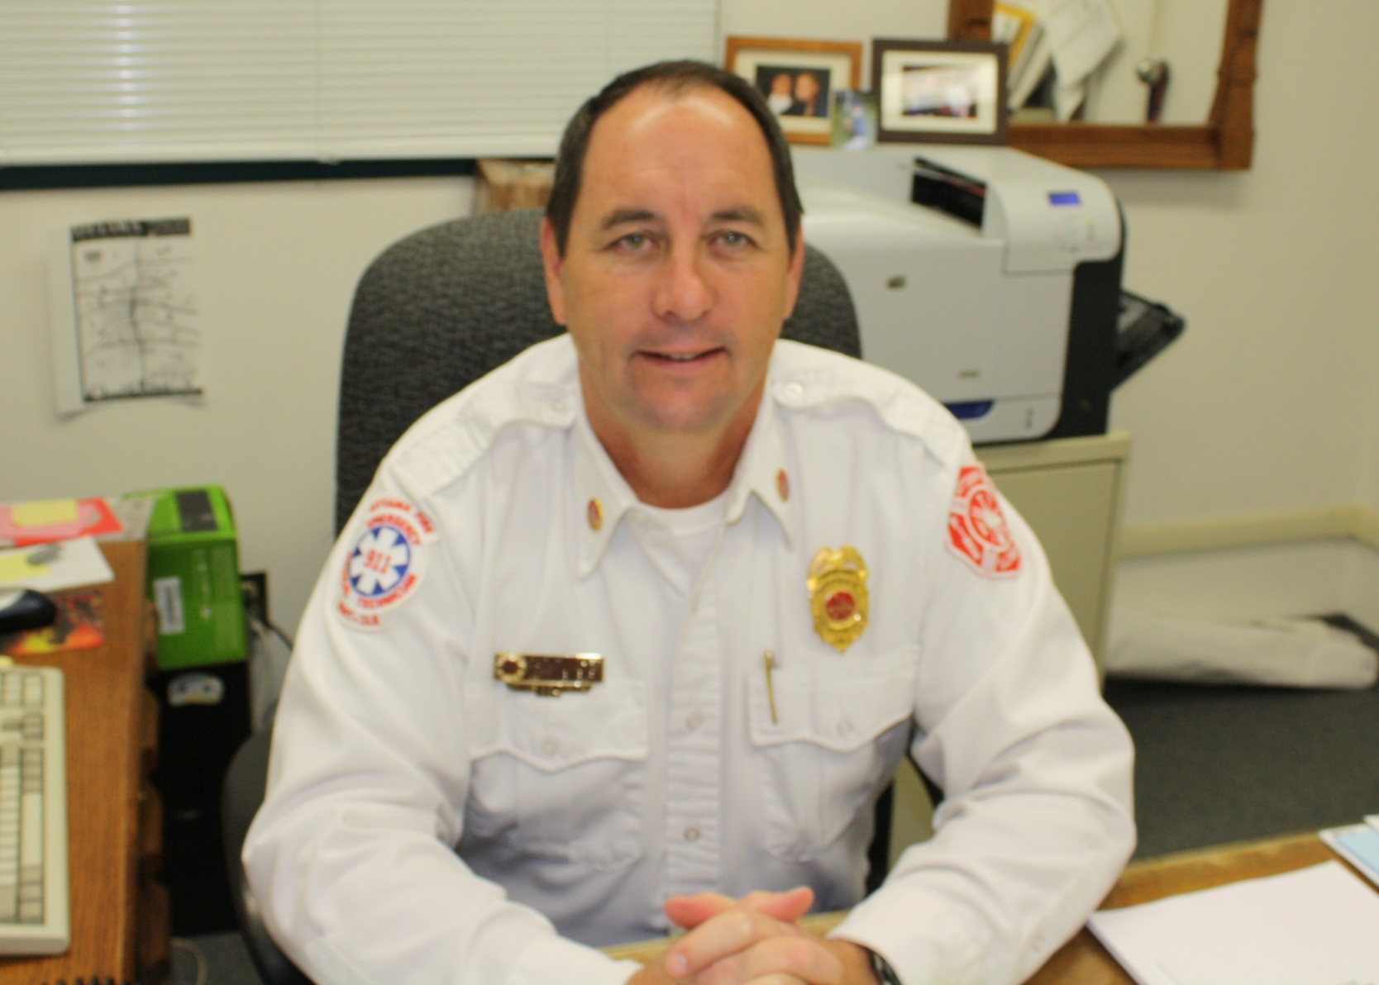
Jeff Newbury

Slide 48
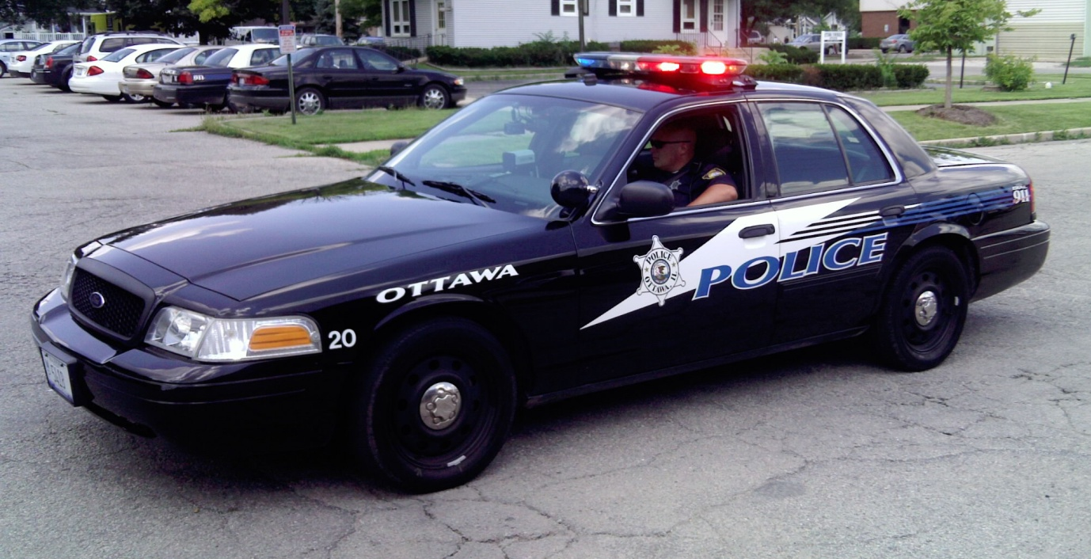
Ottawa Police Department

Slide 49
Juvenile Peer Jury program
School Resource Officers
Child Abduction Response Team
Elderly Service Officers
Emergency Response Team
Child safety seat installation and inspection

Slide 50
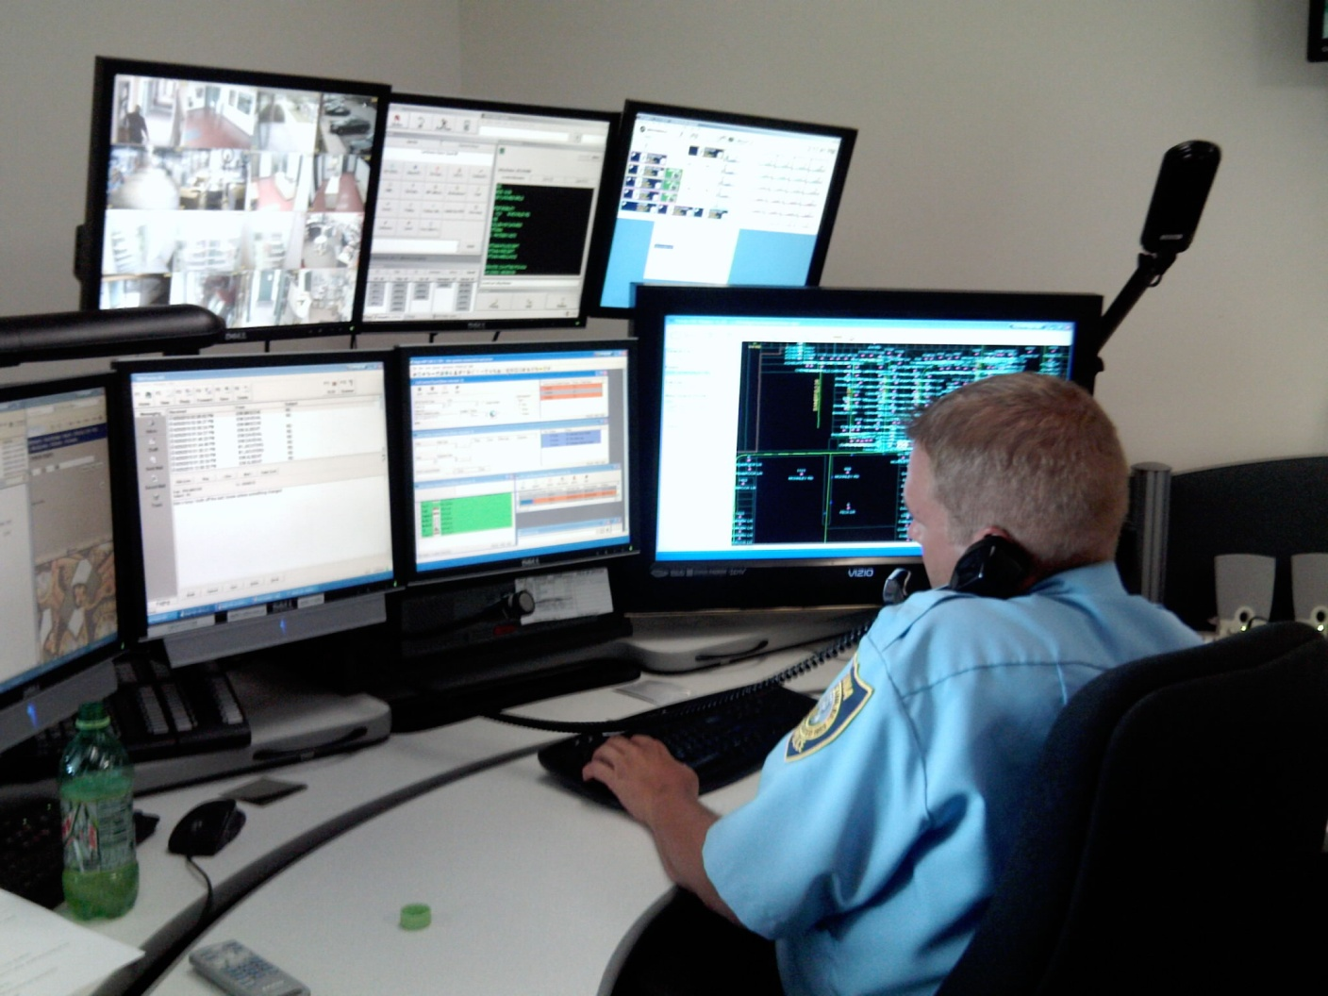
Telecommunicators
Total - 113,000 telephone calls
18,000 - service calls
12,000 - 911 calls

Slide 51
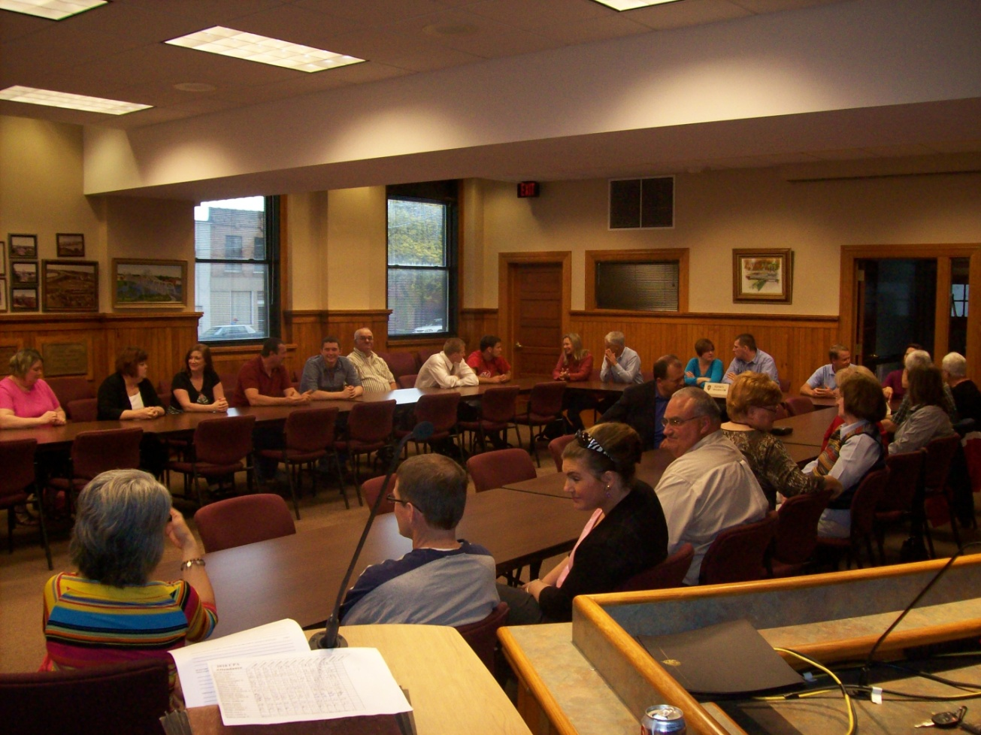
Ottawa Police Department’s Citizen Police Academy program

Slide 52
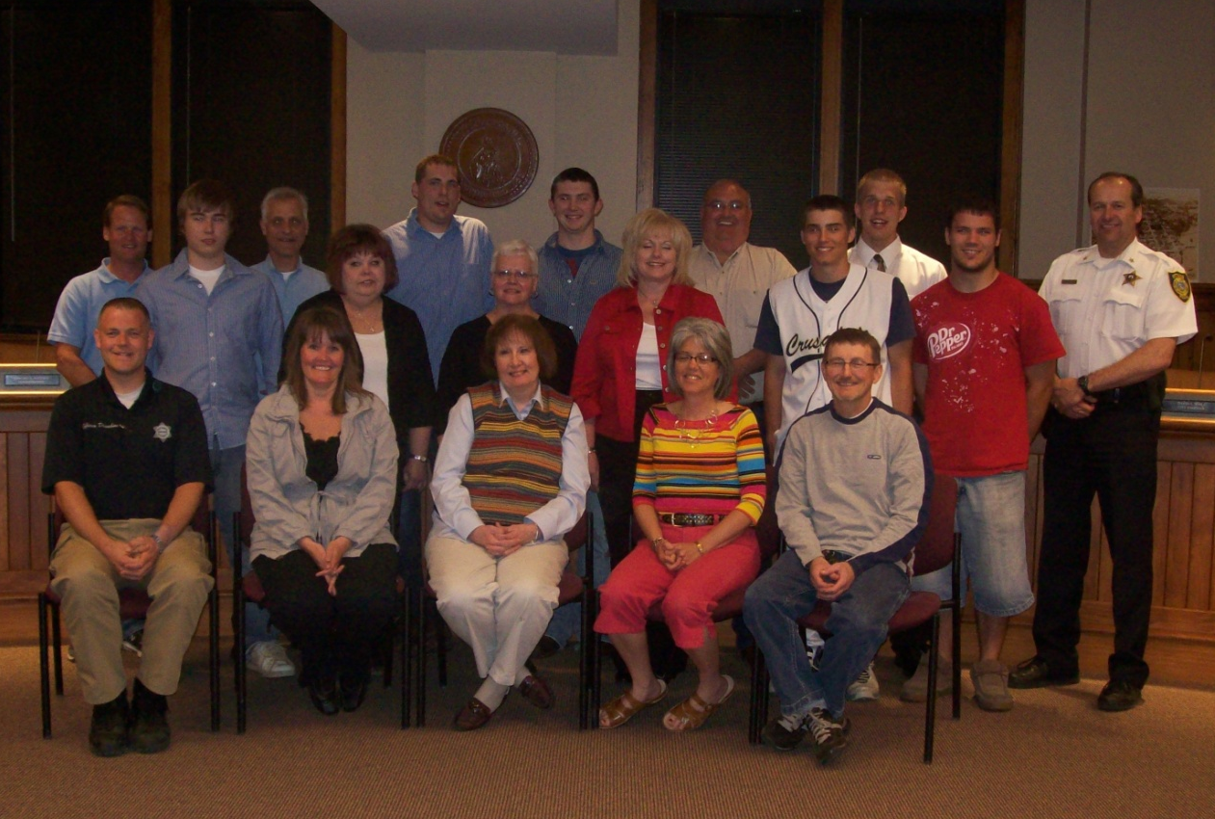
Graduating Class

Slide 53
Ottawa’s Low Level Crime Rate
* 2008 - dropped by more than 20 percent
* 2009 - ½ percent increase from 2008
* 2010 - following the previous two years

Slide 54
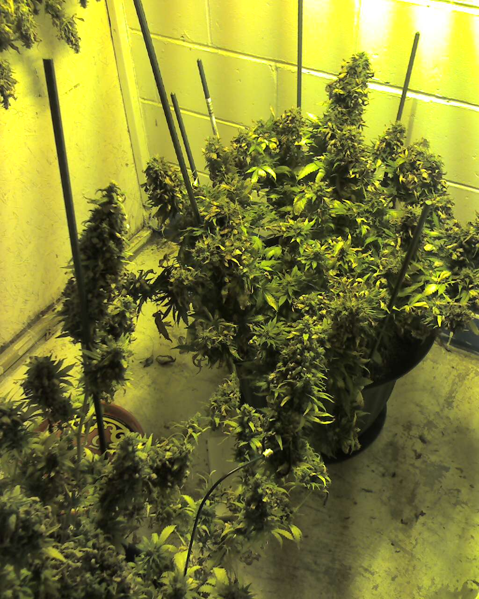
Ottawa Police Narcotics Detectives
58 % increase in drug related arrests by Ottawa Police Narcotics Detectives

Slide 55
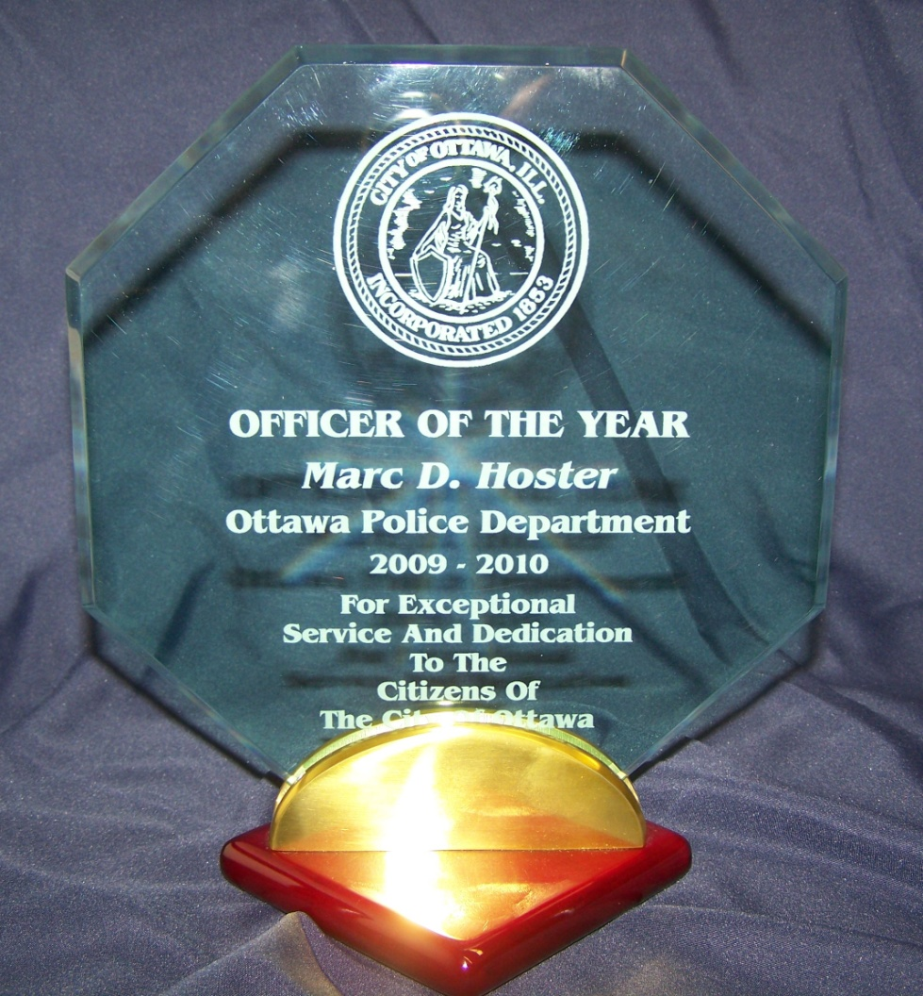
Officer of the Year Award
Marc Hoster

Slide 56

Prescription Pill and Drug Disposal P2D2

Slide 57
Parks,
Playground and recreation

Slide 58

Riordan Pool

Slide 59

Lincoln-Douglas
Playground

Slide 60

Lincoln-Douglas
Park

Slide 61

Lincoln-Douglas Park
Walking Path

Slide 62

Tennis Courts

Slide 63
Active Programs
Largest Amount of Participants
42 Programs
3,500 Individuals
Largest Softball League in the Area
1,800 Men and Women’s Softball Players

Slide 64

New
Park Property

Slide 65
CITY INFRASTRUCTURE

Slide 66
Wastewater Treatment Plant
Total Project Cost $9.2 million

Slide 67

Wastewater Treatment Plant

Slide 68

Wastewater Treatment Plant

Slide 69

Wastewater Treatment Plant

Slide 70

Wastewater Treatment Plant

Slide 71

YMCA Lift Station

Slide 72
Water Department

Slide 73

Well House Rehab

Slide 74


North standpipe
Before
After

Slide 75

Heritage Harbor Watermain

Slide 76

Chapel Street Watermain

Slide 77

Future West Side
Water Storage Tank

Slide 78
Future Water Projects
Painting South Standpipe on State Street
Rehabilitation of North Booster Station on Meadow Lane

Slide 79
STREETS

Slide 80


McKinley Road
New Curb & Gutter
New Sidewalk
New Pavement Section

Slide 81

East Dayton Road

Slide 82




Main Street

Slide 83


Brick Streets

Slide 84

Floodplain Management
Community Rating System --CRS

Slide 85

Federal Emergency
Management Agency (FEMA)

Slide 86

Flooding

Slide 87


Slide 88


IVCC Ottawa Center

Slide 89


IVCC Ottawa Center
Before
After

Slide 90


IVCC Ottawa Center
Before
After
Front

Slide 91


IVCC Ottawa Center
Before
After
West Side

Slide 92


IVCC Ottawa Center
Before
After
Rear – Parking Lot

Slide 93

NIU President John Peters Visit

Slide 94



IVCC Ottawa Center

Slide 95
Downtown Ottawa

Slide 96



Slide 97


Slide 98


Downtown Beautification

Slide 99


800 LaSalle Street Construction

Slide 100




Slide 101



Jordan Block

Slide 102


Washington Park
Volunteer - Anna Mattes
Reddick Mansion
Volunteer - Twila Yednock

Slide 103




Slide 104


Historic Architecture

Slide 105

Peoples Economic
Development Corporation

Slide 106


Historic Architecture

Slide 107


Madison
Street Living
AFTER
BEFORE

Slide 108
Special Events and
Tourism

Slide 109


Special Events Committee
Cruise Night
Music in the Park
Scarecrow Festival
Green Fete Festival
Ice Odyssey

Slide 110

Festival of Lights

Slide 111

Music in The Park

Slide 112


Slide 113

Tourism – Canal Boat

Slide 114


Ottawa Visitors Center

Slide 115


Radium Girls Memorial

Slide 116
Radium Girls Memorial
Fundraising Events
Friday, October 29th 4:30PM to 7:30 PM
Knights of Columbus Hall
December 3rd, 4th & 5th “These Shining Lives”
Ottawa Township High School

Slide 117

Allen Park Sculptures
Mary Fanning

Slide 118


Allen Park Sculptures

Slide 119
Allen Park Sculptures

Slide 120
Allen Park Sculptures

Slide 121
CITY FINANCES

Slide 122

Budget
Total Budget $50 million

Slide 123


Wages and Salaries

Slide 124
Economic Challenges
Employee Pension Plans
Healthcare Costs

Slide 125

Blue Cross Blue Shield

Slide 126

Medical and Prescription
2008/2009 $2.4 million
2009/2010 $1.9 million

Slide 127

Combined Sewer Overflows

Slide 128
Combined Sewer Overflows
City to spend $15 to $26 million dollars over the next 10 years

Slide 129
CSO Long Term Control Plan
Public Meeting Tonight at
City Hall
7:00 PM

Slide 130
CONCLUSION

Slide 131
Special Thank You
to
Mark Pentecost and Skip Hupp for Photos

